Slide 1
Satellite estimates of marine particle sinking speed and particulate organic carbon export
Sue, Henry , Britten, Gregory L. , Primeau, Francois
06/05/2018

Slide 2
Goals
Estimate Carbon Flux using parameters that can be collected using remote sensing
Estimate Carbon Flux using parameters that do not depend on NPP
Generate a sinking speed estimate that more accurately fits empirical data.

Slide 3

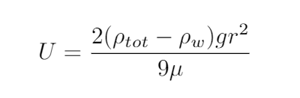
Creating a model
Stokes’ Law
ρtot is Density of Cell
ρw is Density of Water
(Approx. 1023 kg/m³)
g is gravitational constant
(9.8 m/s²)
μ is dynamic viscosity of seawater
(1.07 x 10⁻³ Pa•s at 20° C, 33 g/L Salinity)
Miklasz and Denny, (2010). Hopkins Marine Station of Stanford University

Slide 4
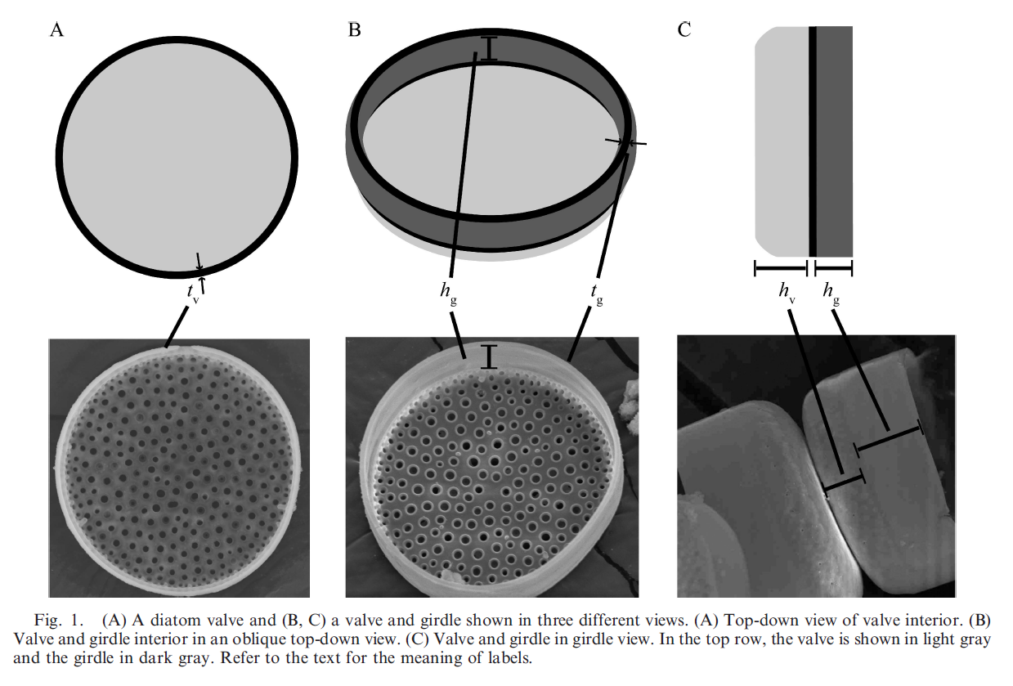
Extended Model
Figure from Miklasz and Denny, (2010). Hopkins Marine Station of Stanford University

Slide 5
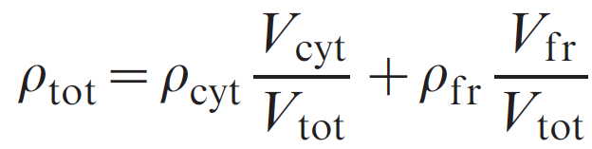
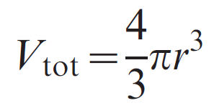
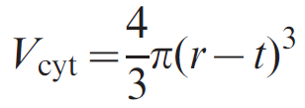
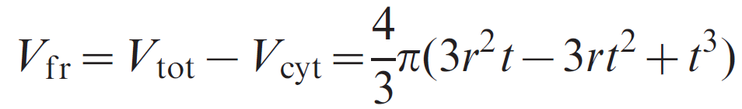
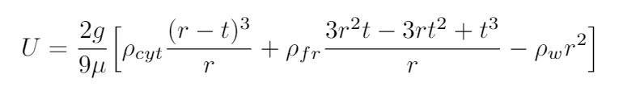
Extended Model cont.
ρcyt is density of diatom cytoplasm
ρfr is density of diatom frustle
t is thickness of the frustle
r is radius of diatom
μ is dynamic viscosity of seawater
g = 9.8 m/s²
Miklasz and Denny, (2010). Hopkins Marine Station of Stanford University

Slide 6
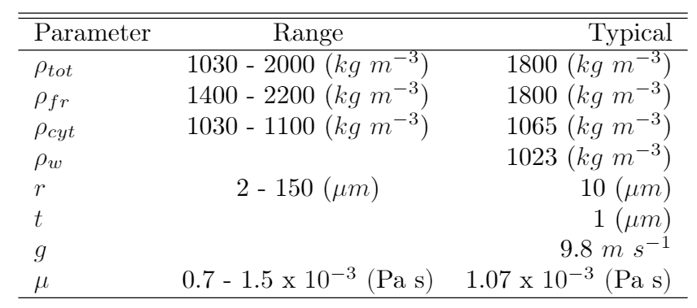
Parameter Ranges
These ranges represent typical values that are characteristic of particles that follow the Stokes’ Law and Extended Stokes’ Law. ρ_{tot} is the total density of the cell, ρ_{fr} is the density of the frustle, ρ_{w} is the density of water, r is the radius of the cell, t is the frustle thickness, g is the gravitational constant, and μ is the dynamic viscosity of water.
Typical density values Miklasz and Denny, (2010). Hopkins Marine Station of Stanford University

Slide 7
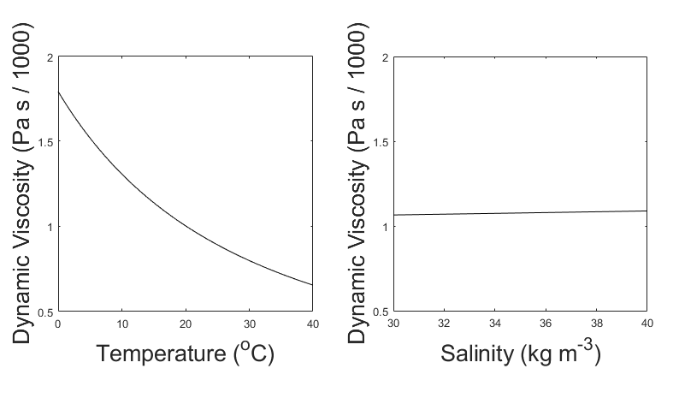
Dynamic Viscosity and Its Effects
Dynamic viscosity varies with respect to temperature and Salinity.
Over the normal range of values for temperature and salinity, dynamic viscosity
is dominated by the effect of temperature.
Pictured: The dynamic viscosity of seawater, variation with respect to temperature (left)
and salinity (right)

Slide 8
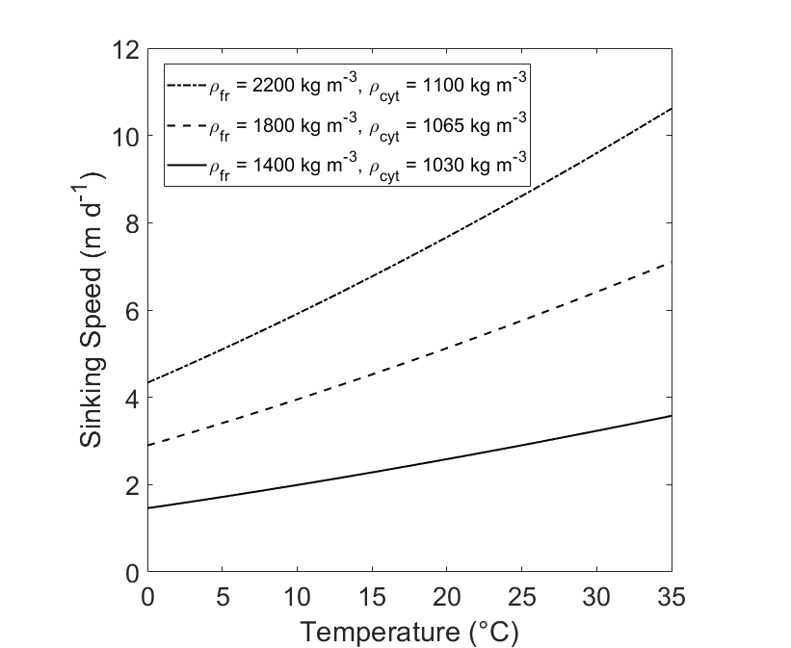
Sample Sinking Speed Estimates
Comparison of Sinking Speed (U) of diatoms at different densities. Sinking Speeds are calculated using the Extended Model. The hypothetical diatoms have radius r = 10 and frustle thickness t = 1 μm

Slide 9
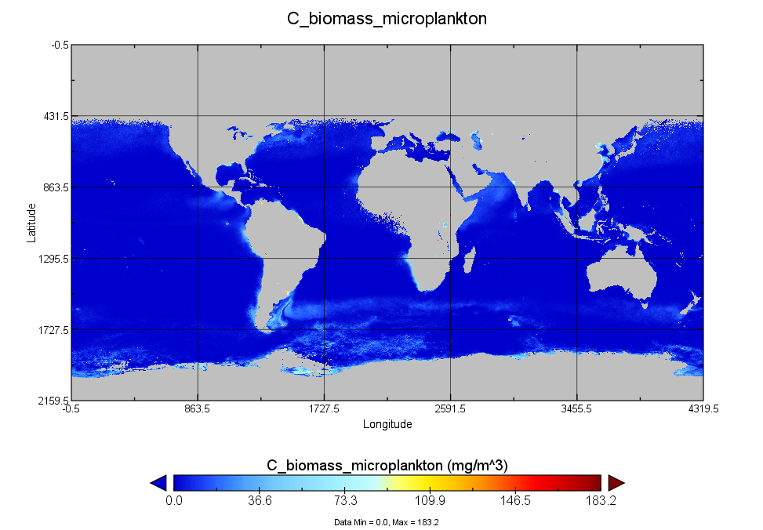
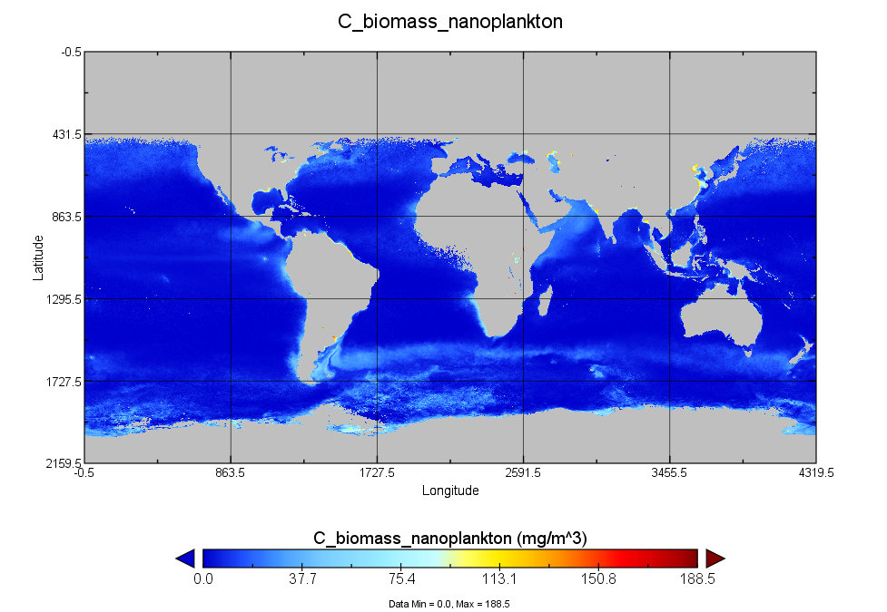
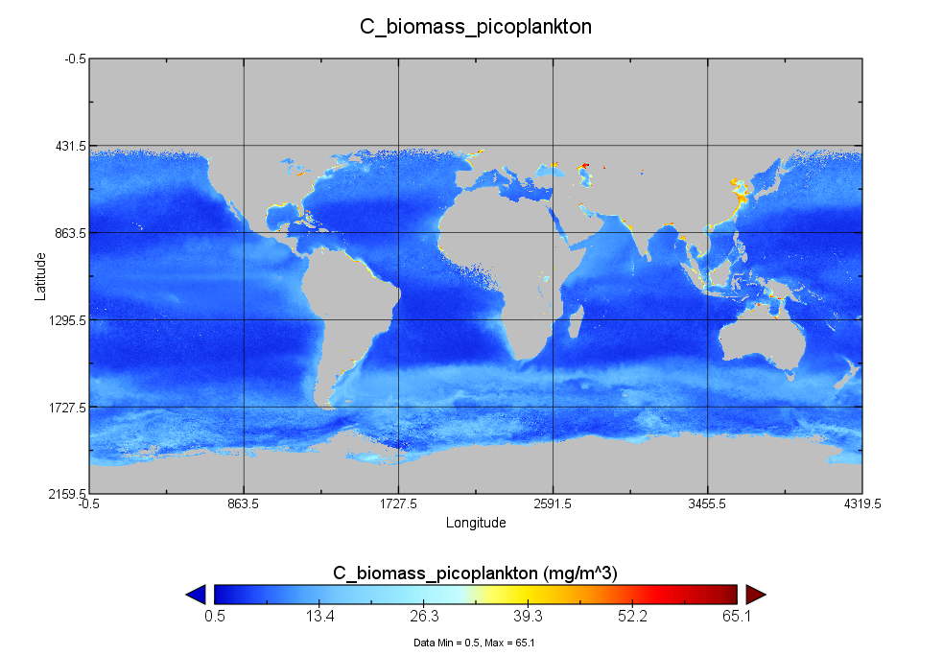
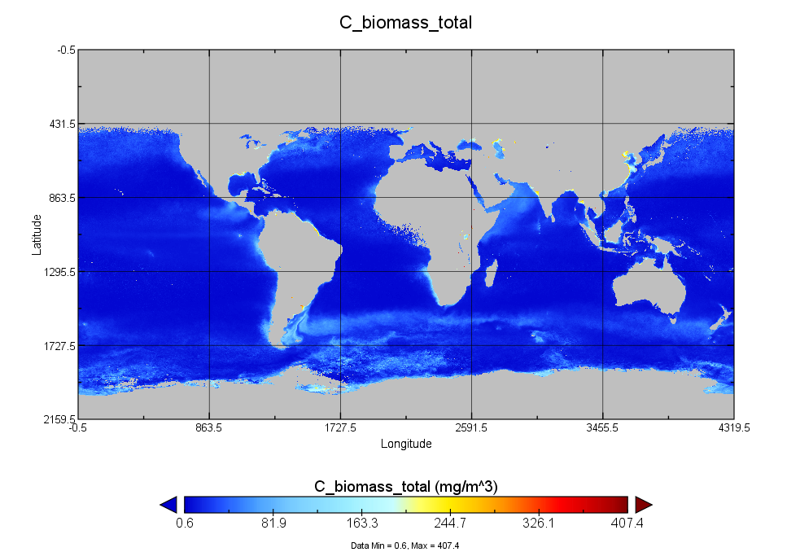
Biomass Percentages for phytoplankton size classes

Slide 10
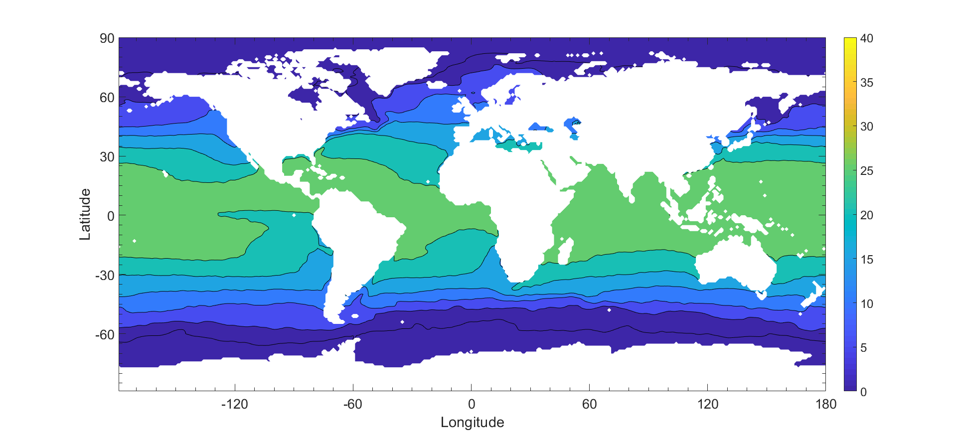
Annual Average Temperature (Year 2012)
Temperature (C)
Temperature Data from WOA Decade Average
Salinity Data from Aquarius
PSD from Kostadinov et al 2009
Pico = 1um, Nano = 10 um, Micro = 35 um

Slide 11
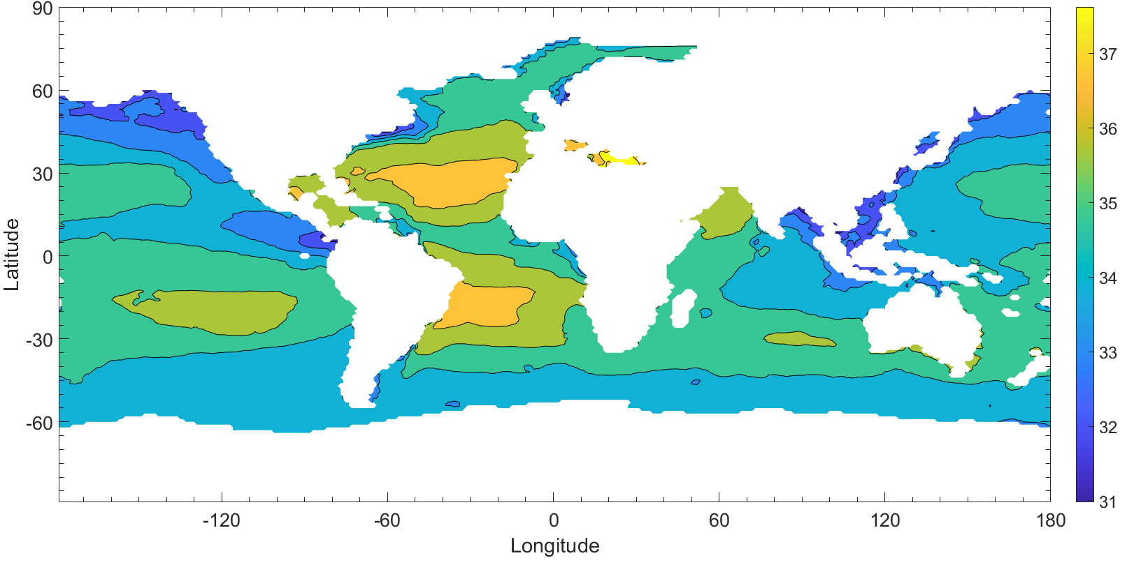
Annual Average Salinity (Year 2012)
Salinity (g/kg)
Temperature Data from WOA Decade Average
Salinity Data from Aquarius
PSD from Kostadinov et al 2009
Pico = 1um, Nano = 10 um, Micro = 35 um

Slide 12
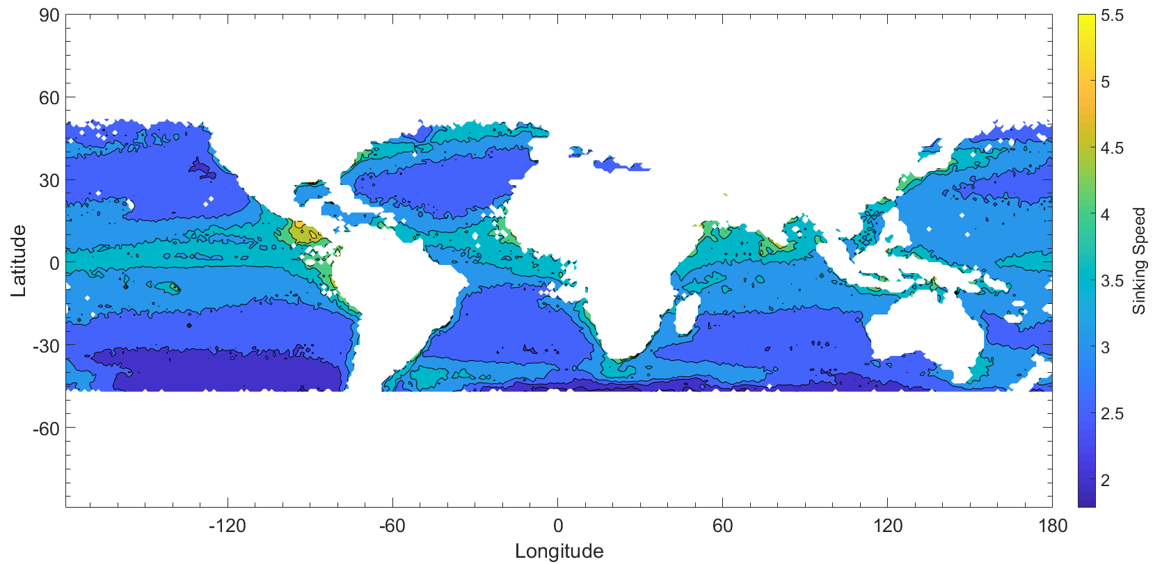
Sinking Speed Prediction (Annual Average 2012)
Annual average sinking speeds of phytoplankton, weighted average per size class
Pico = 1um, Nano = 10 um, Micro = 35 um

Slide 13
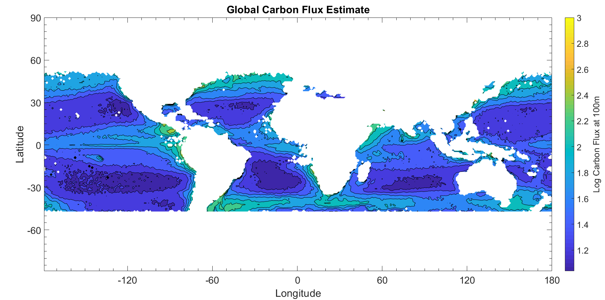
Biomass Export Prediction (Annual, 2012)
Global Map of Log Carbon Flux at 100m Total biomass flux = 1.15 petagrams of carbon

Slide 14
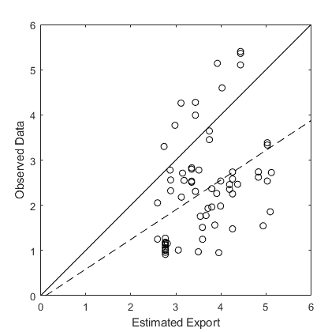
Comparison to Observed Data
Comparison of particulate organic carbon estimate to observed sediment trap data collected by Mouw et al 2016.
R² = 0.1450
RMSE = 1.1572
Line of best fit: y = 0.6580x - 0.0742

Slide 15
Going forward
Create a more robust model
Identify potential causes of data noise
Model export of other organic matter (silica, nitrogen…)

